Slide 1
United Nations Conference on Sustainable Development: Austria‘s contribution to Rio+20
Sustainability field trip to Austria – September 2012
Graz, 11. September 2012
Marlene Mader, RCE Graz-Styria, University of Graz

Slide 2
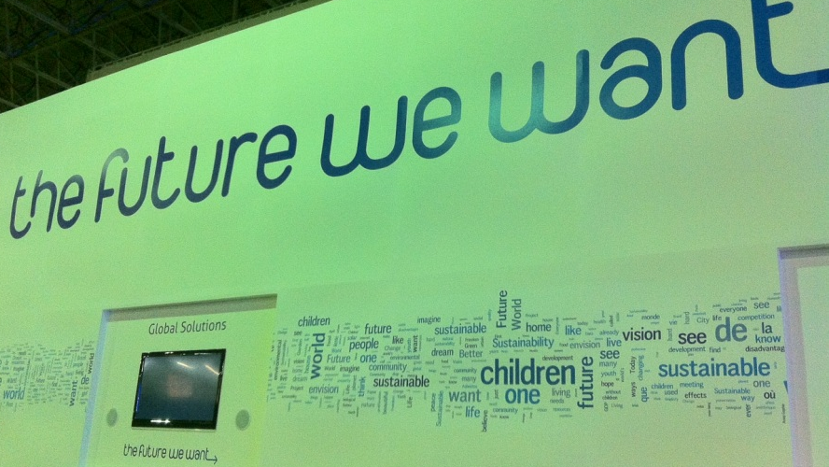
UN Conference on SD: June 20-22, 2012, in Rio de Janeiro
Approx. 50 000 participants (conference + side events)
www.uncsd2012.org/rio20/
Focus on two themes:
green economy in the context of poverty eradication
institutional framework for sustainable development

Slide 3
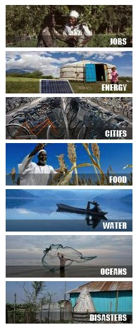
1. Green economy
Goals:
Improving the living conditions of people
Ensuring social equity
Minimising environmental risks
Fostering biodiversity
7 prioritised subareas:
Decent jobs
Energy
Sustainable cities
Food security & sustainable agriculture
Water
Oceans
Disaster readiness

Slide 4
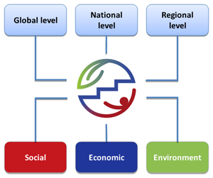
2. Institutional framework for sustainable development
Objectives:
enhancing UNEP
establishing a new umbrella
organization for sustainable development;
creating a specialized agency such as a
world environment organization;
introducing possible reforms to ECOSOC and the CSD; and
enhanced institutional reforms and streamlining of present structures.

Slide 5
Conference procedure
500 side events
(June 13-22)
3 Prep-Com Meetings
(May ‘10, March ‘11,
June 13-15 ’12 )
SD Learning
(June 13-22)
UN Conference
(June 20-22)
The Future We Want Prep. Meeting under Brazil lead (June 16-18)
SD Dialogue Days
(June 16-19)
Partnership Forum
(June 20-22)
Other events
(e.g. fairs, exhibitions)
(June 13-22)

Slide 6
Conference procedure
Three Prep-com (= preparatory committee) meetings
In May 2010, March 2011, June 2012 (to agree on objectives and themes for the conference)
UN, member states and expert groups negotiate and prepare the outcome document
After the TFWW could not be finished during PrepCom Meetings, Negotiation lead was handed over to Brazil as conference host who finalised the document (June 16-18th 2012)
Side events
Around 500 official side events, where civil society, science and economy discuss
Focus on thematic solutions for global challenges & new co-operations
essential pillar of the conference

Slide 7
Conference procedure
SD Learning
Capacity building events for SD
SD Dialogue Days
A forum for civil society
To engage in an action-oriented debate on SD key topics (migration, poverty, financial crisis, forests, food water, etc.)
Partnership Forum
To highlight the importance of partnerships
Organised by UN departments and networks
Other events
E.g. fairs, exhibitions, …

Slide 8
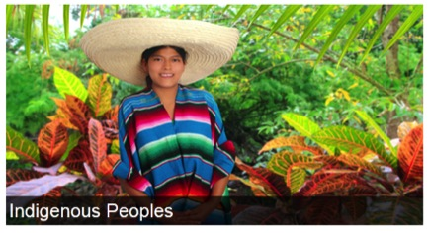
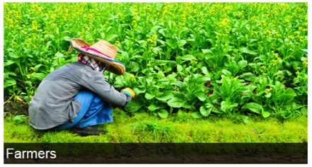
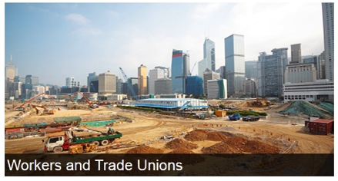
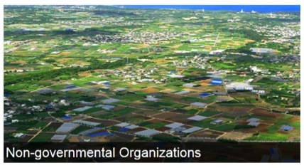
Major groups in Rio
Governmental efforts are not enough → an active participation of all sectors of society and people is needed

Slide 9
Outcome document: The Future We Want
53 pages, 6 chapters, 283 articles:
Our common future (articles 1 - 13)
Renewing political commitment (articles 14 - 55)
Green economy in the context of sustainable development and poverty reduction (articles 56 - 74)
Institutional framework for sustainable development (articles 75 - 103)
Framework for action and follow-up (articles 104 - 251)
Means of implementation (articles 252 - 283)

Slide 10
The Future We Want – excerpt of important aspects
Our common future:
Eradicating poverty as the greatest global challenge (2).
Draws again attention to meet the MDGs (5).
Prerequisites for SD are freedom (8), human rights (9) and democratic, accountable and transparent governance structures (10).
Importance of partnerships & Education for All (11).
SD can only be achieved with a broad alliance of all actors (society, governments, private sector) (13).
Renewing political commitment
Reaffirming the Rio principles and past actions (e.g. Agenda 21, Rio declarations, MDGs,..) (14-18)
Advancing integration, implementation and coherence (refers to unsustainable practices and challenges; current activities and programs,..) (19-41)
Engaging major groups and other stakeholders (42-55)

Slide 11
The Future We Want – excerpt of important aspects
Green economy in the context of SD and poverty reduction
There exist different approaches and models in each country to achieve SD. Green economy in the context of SD and poverty eradication as one of the important tools for achieving SD. (56)
Green economy should enhance/improve: economic growth, social inclusion, human welfare, create opportunities for employment and decent work for all, while maintaining a sound ecosystem (56).
Importance of education, capacity building and training (62)
Role of technologies and technological transfer to developing countries (72-74).

Slide 12
The Future We Want – excerpt of important aspects
Institutional framework for sustainable development
Institutional recommendations to be implemented at international, national, regional and local level:
by strengthening all dimensions of SD (75-76)
by strengthening intergovernmental arrangements for SD (77-86)
General Assembly (GA): discuss SD at highest level
Economic and Social Council (EcoSoc): enhanced role to foster SD at the global level
High-level political forum (HLF): replaces the Commission for SD; tasks: fostering dialogue and co-operations, evaluations, political advice
environmental pillar of SD (→ role of UNEP) (87-90)
International financial institutions and UN operational activities (91-96)
Regional, national, subnational and local levels (97-103)

Slide 13
The Future We Want – excerpt of important aspects
Framework for action and follow-up
Thematic areas and cross-sectoral issues (104-244) (e.g. poverty eradication, food security and sustainable agriculture, water and sanitation, energy, sustainable tourism, transport, sustainable cities and human settlements, health, employment and decent work, oceans, disaster risk reduction, climate change, forests, biodiversity, consumption and production, education,..)
Sustainable Development Goals: based on MDG and Agenda 21; will be developed by the Sustainability Solution Network (chaired by Prof. Jeffrey Sachs) (245-251)
Means of implementation
Essential means to achieve SD: are required: finance, technology, capacity-building, trade, registry of commitments (252-283)

Slide 14
Successes & positive voices:
Development of „Sustainable Development Goals“, which will be defined until 2015 – with close participation of science and society
Establishment of a “High Level Political Forum”, which replaces the UN Commission for Sustainable Development and puts SD at the highest political level (Economic and Social Council)
Strengthening the UN Environment Programme (UNEP)
Key role of science and society, which calls for more transdisciplinary research
New dialogues between science, society, economy, politics, NGOs
Draws global attention to the need of SD

Slide 15
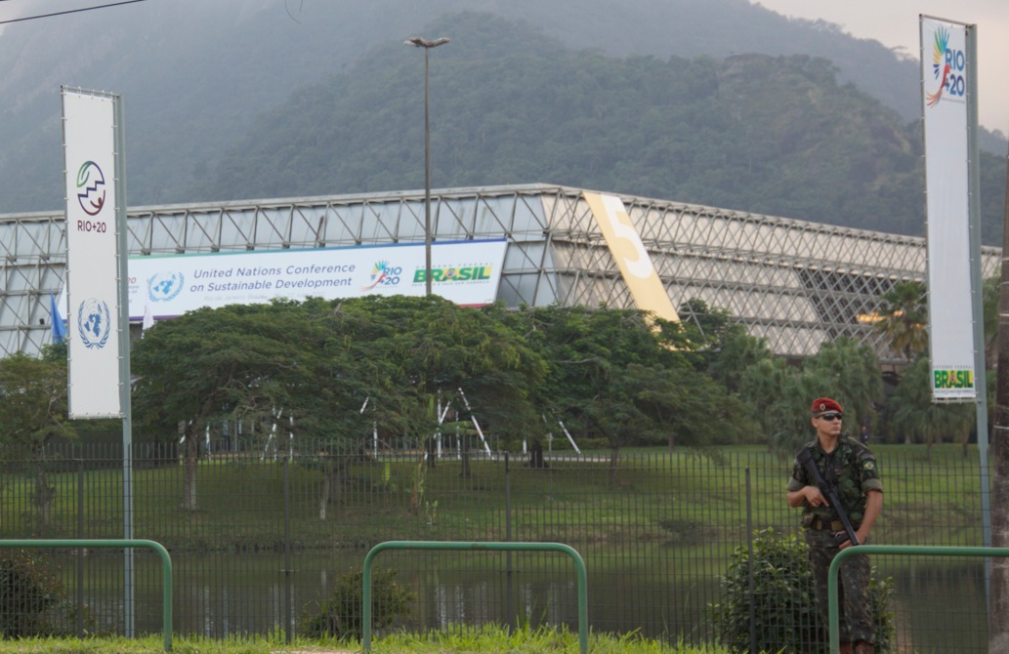
Negative voices
Huge meeting and travel costs (and CO₂ emmissions) for ‘nothing’
Outcome document without concrete goals
Developing countries: “Green economy as a license for developed countries to exploit further resources”
Political negotiations are sobering

Slide 16
Further outcomes: Peoples‘ Sustainability Treaties
Civil society initiates own dialogues to influence policy, defines own objectives, establishes new co-operations, …
14 treaties – developed by major groups:
Consumption & production
Equity
Sustainable economics
Radical ecological democracy
Sustainable development governance
Rights of Mother Earth
Sustainable Development Goals
Environmental ESD and global responsibility
Ethical and spiritual values for SD
Transitioning to a Zero fossil fuel world
Rights for sustainability
CSR and accountability
Higher Education towards SD
Charter of universal responsibility
(see: http://sustainabilitytreaties.org/)

Slide 17
Further outcomes: Peoples‘ Sustainability Treaties
Peoples’ Sustainability Treaty on Higher Education
Lead by COPERNICUS Alliance; developed by 25 HE agencies, organisations, associations and student groups
Those signing the treaty are committing to contribute towards societies that are fair, participatory, future facing and peaceful and able to restore the integrity of Earth’s ecological systems, as well as promote human development in an equitable and inclusive manner.
They commit to change at five levels: cultural, campus, curriculum, community engagement, connecting the system
They commit to implement immediate actions (- mid 2013), short-term actions (2012-2015), medium-term actions (2016-2025) and long-term actions (post 2026)

Slide 18
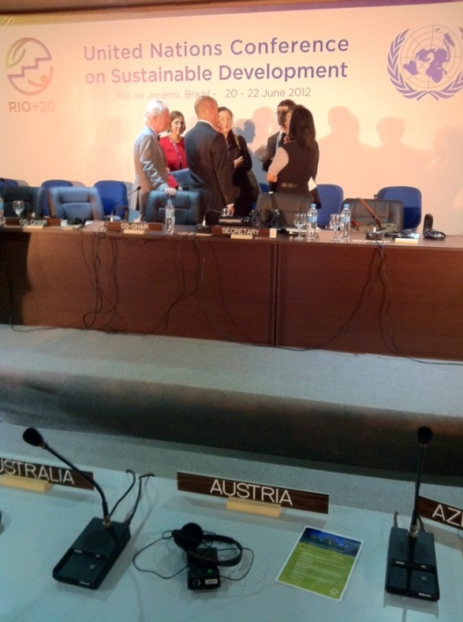
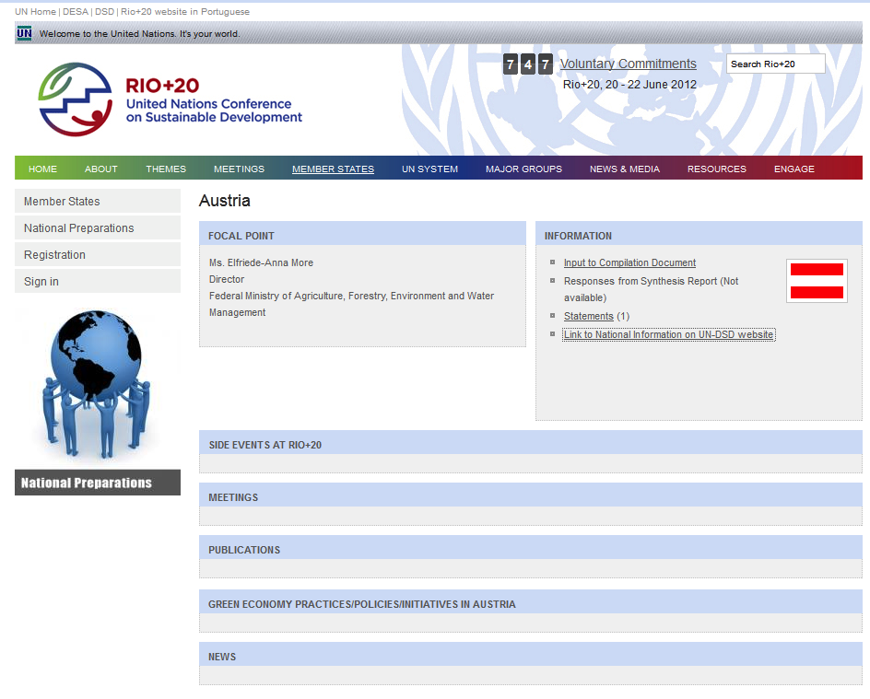
Austria‘s contribution to Rio+20
Austria missed to organise side events and meetings as lead partner but was present by giving statements to various events, esp. in the field of research, higher education and RCEs.

Slide 19
Austria‘s official delegation in Rio
Austrian official delegation: app. 20 people
From: Austrian Federal Ministry for Science and Research (r. Clemens Mader (Leuphana University Luneburg, RCE Graz-Styria) and Philipp Schöffmann (RCE Vienna))
Austrian Federal Ministry of Agriculture, Forestry, Environment and Water Management
Austrian Foreign Ministry
Political parties (Green party)
Youth representative
Highest representative: Wolfgang Waldner (State Secretary of Foreign Affairs) → no ministers (Nikolaus Berlakovich, Minister for the Environment, canceled his participation at short notice)
Coordinator of the delegation: Elfriede-Anna More (Federal Ministry of Agriculture, Forestry, Environment and Water Management)

Slide 20
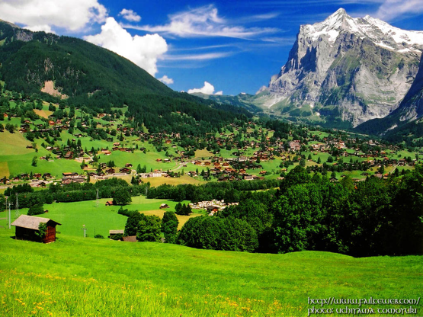
Austria in Rio
Important thematic areas:
Mountains and the Alps region
Water
Mrs. More: discussion chair within the EU for mountains and oceans & seas

Slide 21
Side events with Austrian participation
Aiming higher, unlocking tertiary education's potential for SD
Organised by university networks, e.g. Australasian Campuses Towards Sustainability, COPERNICUS Alliance, AASHE (Association for the Advancement of Sustainability in Higher Education), GUNI (Global University Network for Innovation), ProSPER.Net, etc.
Austria’s statements:
Importance of UN Decade on ESD (2008: Austrian strategy for ESD, national service office for UNDESD, RCEs, Sustainability Award by ministries)
Importance of transdisciplinary research and education (funding activities: e.g. Sparkling Science, sust. oriented td PhD programme, student organisations)
Importance of innovative sustainability assessment and appraisal initiatives for Higher Education (i.e. AISHE, cooperation with COPERNICUS Alliance and UNU)
Open Science for Sustainability (online information and exchange platform)

Slide 22
Side events with Austrian participation
UNU side event: Multi-stakeholder Learning towards Green Society
By RCEs, COPERNICUS Alliance, UNIDO, UNDP
With the aim to contribute to a better understanding of the role of multi-stakeholder initiatives; and explore potential global-local partnerships

Slide 23
References
Austrian Federal Ministry for Science and Research: Open Science 4 Sustainability, www.openscience4sustainability.at
UN Conference for SD (official website Rio+20), www.uncsd2012.org/
Twitter account by Clemens Mader, https://twitter.com/CMader_Sustnews, and personal conversations
Peoples‘ Sustainability Treaties: http://sustainabilitytreaties.org

