Slide 1
European Virtual Seminar WS 2013/2014 Research report THE ARLBERG REGION - Linking mass tourism and sustainability in the Arlberg region
by
STR2 - Sustainable Tourism and the Region
(Donatilde Catarino, Christoph Huber, Alina Marincan, Uta Scheffler, Carina Wolf)

Slide 2
Group members
1) Donatilde Catarino: I'm a student in Universidade Aberta, master in Environmental Citizenship and Participation, Portugal
2) Christoph Huber: I study Geography and History for teaching and now I am in my 7th semester, great skier, Austria
3) Alina Marincan: I've graduated the college of Gegraphy, specialisation on Tourism, Romania
4) Uta Scheffler: I studied biology and French at the university of Freiburg, enthusiastic skier, Netherlands
5) Carina Wolf: I´m 21 years old and studying maths and geography for becoming a teacher and maths (Bac) in Graz; Skiing Instructor and KIds entertainer in der "Burg" (Lech am Arlberg), Austria

Slide 3
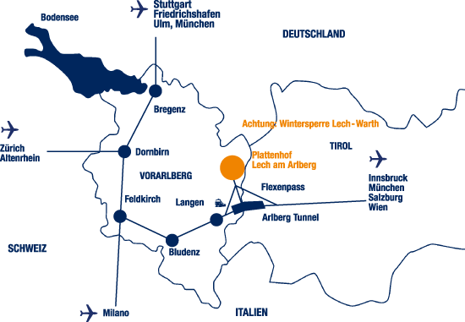
Arlberg, “the cradle of alpine skiing”
- an Austrian mountain massif
- situated between Vorarlberg and Tyrol,
- at an altitude between 1300 and 2811m
- well known for its popular places and fantastic ski resorts such as Lech, St. Anton, St. Christoph, Stüben and Zürs

Slide 4
Introduction
The aim of our research:
- the tourism policy in Arlberg equaly respects: the economic,
the social and
the environmental dimensions or:
- if it only pursues economic goals, putting in danger the equitable access to the ressources
for the present and /or
the future generations

Slide 5
Tourism Policies
82 % of all guests come in winter season
In winter season 2012/13 only 7,72% of the overnight stays were made by Austrians
=> special events for tourists from abroad, seasonal workers with English mother tongue
Garni model is dominant: family run, have usually between 1 and 15 rooms and serve normally only breakfast.
highest prices of lift tickets in Austria

Slide 6
Sport infrastructure and events
340 km of marked ski runs and 200 km of off-piste options with 94 lifts
a huge varierity of different leisure time offers
White Ring
various event: from traditional feasts over educational events to Spring festivals

Slide 7
Analysis on the proposed strategies which involve development and innovation in the region
“most beautiful village in Europe" in 2004;
natural surroundings, rare herbs and the variety of blossoms, offering 20 different types of orchids;
two additional summer projects were realized: the“Grüner Ring” hiking route was opened as the summer equivalent to the white winter version, The Erlebnisregion Tannberg was also launched, which extends beyond Lech to include the regions of Warth and Schröcken; -the reforestation projects, plants are also supplied to institutions such as the Mountain Torrent and Avalanche Barrier;
concept of “Eco-regions” the combination of sustainable farming in particular organic farming practices, and the marketing of their produce with the aim of assisting regional development ;
extending over more than 30,000 square metres, the recreation area includes a small lake and fountain, footpaths which lead through the park-like gardens, benches and peaceful zones ;
opening of an e-bike hire centre in Lech in Summer 2011 e-bikes were hired out over 400 times during the summer season;

Slide 8
Current situation:
Many sustainable initiatives in different areas as:
Transport
Energy
Development
Water
Waste
Territorial
Main problems:
It is a seasonal activity.
The growing competitive edge both on summer and winter time
Almost 70 per cent of the visitors come from Europe.
The international economic crisis and the development of tourist tendences
Demographic transformations: aging population

Slide 9
Suggestions:
Good marketing strategies to promote the touristic offer of the region in other countries and continents may help to open the region to other markets increasing the number of visitors both in summer and winter time.
Better utilization of infrastructure: as for example the event and congress centre in St. Anton, to invest in Business Tourism.
Health tourism
Increase of alternative activities as Snowpark Lech in order to attract people who don’t appreciate or can’t practice ski
Development of agro-tourism
Creating special prices for students
Agreements with the airports and low cost entrepriseste to face the present touristic tendences: seeking to expend less in the transportation and more in the stay / shortbreaks, acessed against reductions in per capita emissions and the increased adoption of carbon footprint mitigation strategies

Slide 10
Conclusion
The text represents the evaluation and research of tourism of Arlberg Region and its communities, the mass tourism and sustainability development.
Although the principal conclusion was that tourism's influence was positive, there were also reported some unexpected and less desired conclusions.
In the project and research we follow the main and the most efficient projects that involved the development and the sustainability of the region, also we had mention the tourism policies, the statistics per years about the tourist flows, the infrastructure that was made concerning the winter sports, the expansion of ski slopes, the expansion of new parks, green areas, summer tours, also the transport infrastructure, industry and energy sources of the region.
There were made suggestions during the time to accomplish others opinions and strategies who may wish to transform to tourism as a efficient modality of enhancing community development. We can say that the expression “soft tourism,” is presented as a method for living harmoniously with tourism.

Slide 11
drawing conclusion of our research, we can say that Arlberg region represents a polarizing center characterized by tourist flows, variety, innovation and strategies wich involve sustainability. Although, we can say that Arlberg region meets all the steps to become one sustainable.

