Slide 1
The Sustainability Process at University of Graz
Sustainability Excursion – September 2012
Graz, 11th September 2012
Mario Diethart, RCE Graz-Styria, University of Graz

Slide 2
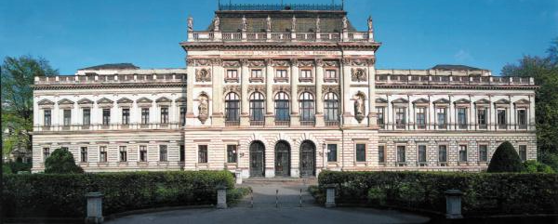
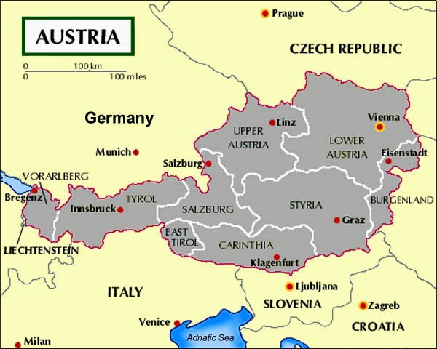
Karl-Franzens-University Graz
since 1585
30.000 students
3.800 staff
6 faculties
Catholic Theology
Law
Faculty of Social and Economic Sciences
Environmental and Regional Sciences and Education
Faculty of Arts and Humanities
Faculty of Natural Sciences
Interdisciplinary Studies
74 departments
100 curricula

Slide 3
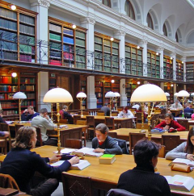
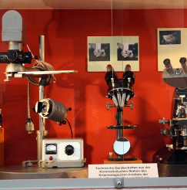
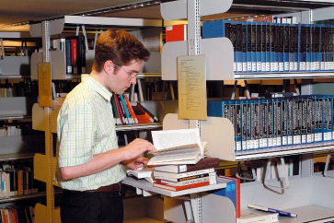
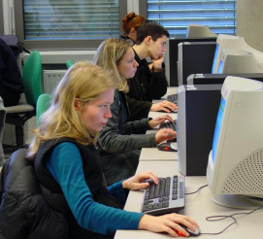
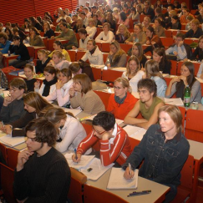
The University of Graz aims to …
…educate responsible future decision makers
…research for innovation for sustainable development
…manage to be a role model for sustainability
…outreach & exchange to co-develop the social, natural and economic environment with society and stakeholders

Slide 4
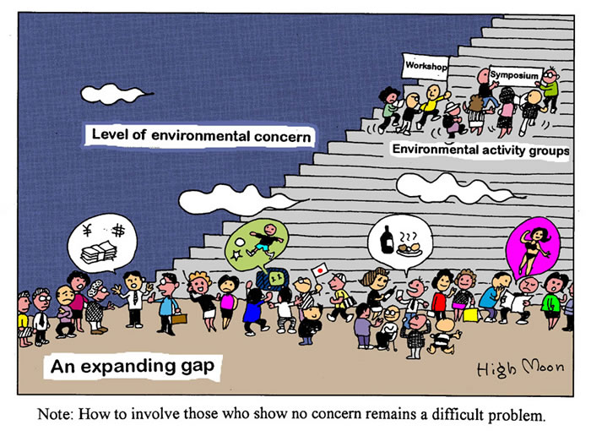

Slide 5
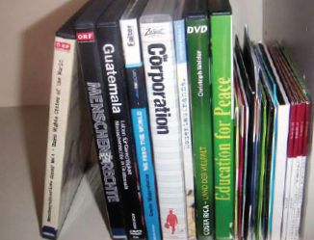
Selected actions by the University of Graz – EDUCATION
Environmental
System Sciences 1991
Environmental
System Sciences
in curriculum 2003
Sustainability
library
2003
Virtual Campus
for a Sustainable
Development (VCSE)
2005
Global Studies
2007
MSc Sustainable
Urban and Regional
development 2007
MSc
Interdisciplinary
Gender Studies
2007
Joint MSc program
Sustainable
Development
2008
MSc
Global Studies
2010
MSc
Erasmus Mundus
Industrial Ecology
2011
Joint PhD
Diversity Mgmt and
Governance
2011
Lectures, excursions,
intergenerational
courses...

Slide 6
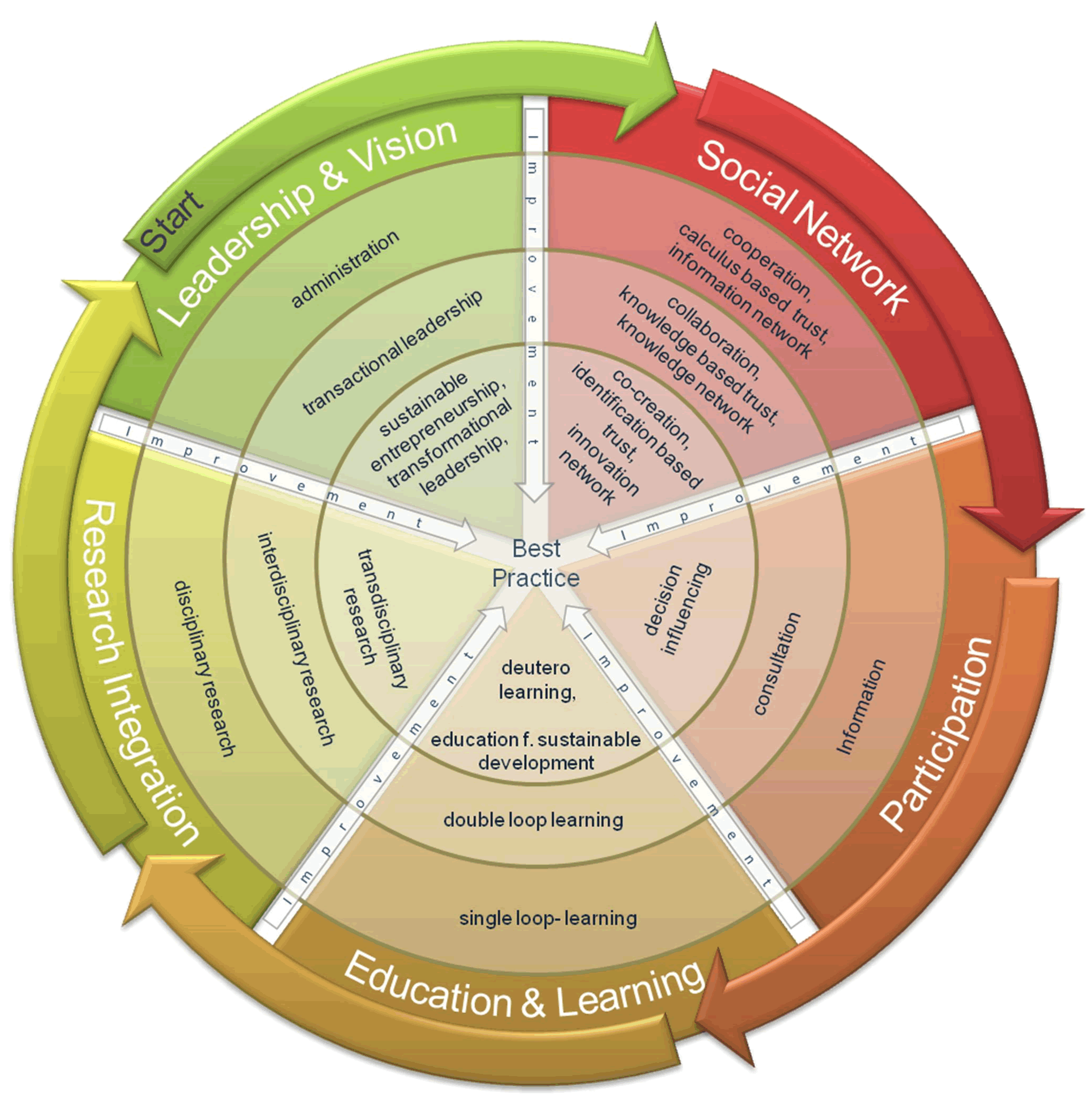
Selected actions by the University of Graz – RESEARCH
Climate change
and sustainable
development
Sustainable urban
and regional
development
Integrative
development
processes
Human rights
EduCamp
2010-2013
ICTeESD
2010-2012
SUSTAINICUM
2012

Slide 7
Selected actions by the University of Graz – MANAGEMENT I
COPERNICUS
Charta 1995
oikos Graz
student organisation
2002
Sustainable
university strategy
2004
Task Force “Sustain.
University Graz”
2004
ECOPROFIT
2005
RCE Graz-Styria
2006
University bike stations
2007
Faculty of Environ-
mental & Regional
Sciences & Education 2007
Inst. for System
Science Innovation
& Sust. Research (ISIS)
2007
Sustainability
Coordinator
2008
Institutionalisation
of RCE Graz-Styria
2009
COPERNICUS Alliance
2009

Slide 8
Selected actions by the University of Graz – MANAGEMENT II
Sustainability4U 2009
Energy Map 2011
Climate neutral
University of Graz
2011
Digital University Graz
2012

Slide 9
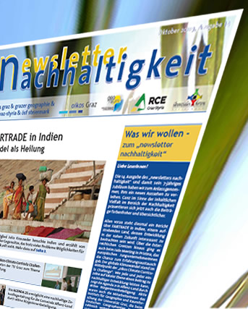
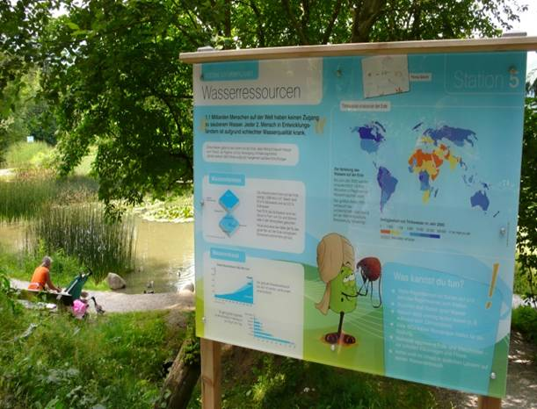
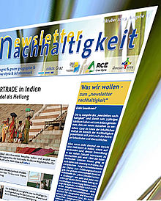
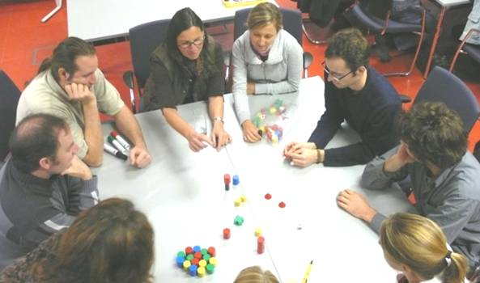
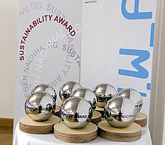
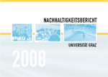
Selected actions by the University of Graz – OUTREACH & EXCHANGE
Sustainability
newsletter since 2003
Children University
“KinderUni”
2004
1st
Sustainability report
2006
RCE Graz-Styria
2006
Public lecture
“Montagsakademie”
2008 (since 2004)
Sustainability Trail
2008
Sustainability
website
2008
Sustainability Award
2008
2nd
Sustainability report
2009
Dual Career Service
2011
3rd
Sustainability report
2012
Mobility4ALL
2012

Slide 10
RCE Graz-Styria
Mission
RCE Graz-Styria contributes to a Sustainable Development on global and regional level. With innovative and transdisciplinary education and research based in its focus groups „Education for Sustainable Development“ and „Sustainability Strategies and Sustainability transitions“ it fosters a knowledge exchange between university and society.

Slide 11
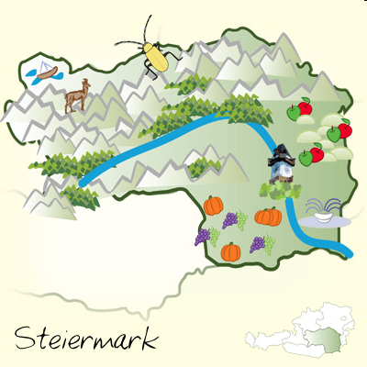
RCE Graz-Styria
since 2006
2007 acknowledged by UNU
2009 institutionalisation
> 30 partners
(regional, national, international)
Challenges

Slide 12
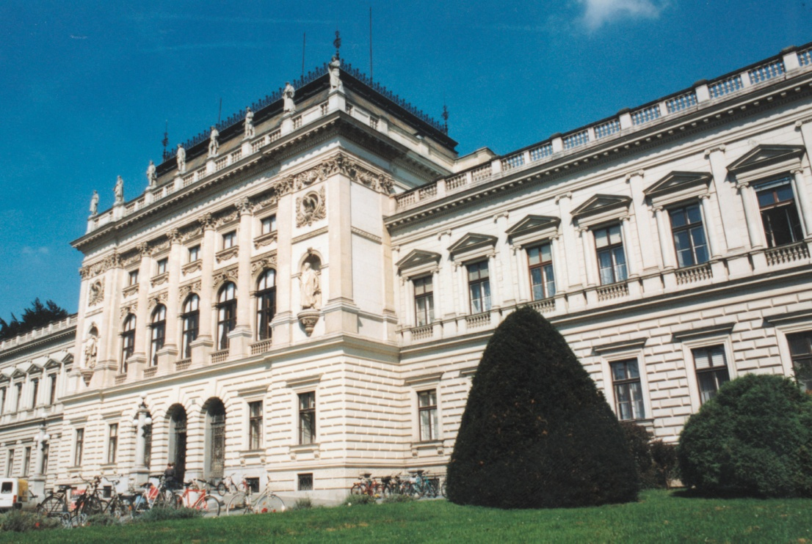
Thank you for your attention!
Mario Diethart University of Graz RCE Graz-Styria
www.rce-graz.at mario.diethart@uni-graz.at

