Slide 1
Geoconservation in HaTeg Country Dinosaurs' Geopark
EVS 2013-2014 GEO2 Group

Slide 2
topic of the case study
Sustainable Geoconservation in HaTeg Country Dinosaurs' Geopark
EVS 2013-2014 GEO2 Group

Slide 3
central research question
How can we enforce the local and cultural identity from the inhabitants of the Hateg Geopark
EVS 2013-2014 GEO2 Group

Slide 4
research approach
Using the Internet to research for bibliography on Hateg community
Using the advantage of having the director of the Geopark as the expert
Using the points of view of the group about European Geoparks
Combined efforts for all the areas that we had experts in
Tourism
Economics
Geology
Social behavior
Cultural heritage
Environment
Romania
EVS 2013-2014 GEO2 Group

Slide 5
Economy of hateg
Economy of Romania
Workforce Better than other European countries, Low unemployment
Poverty line Positive evolution, 4 million people
Purchasing power Positive evolution, In other countries, the evolution is better
Export Electricity and petroleum, Positive effect
Industry Textile, forestry and food industry
Purchasing power Higher than the average, Good welfare
Unemployment Higher in comparison with other provinces, 1250 people have no job in Hunedoara
EVS 2013-2014 GEO2 Group

Slide 6
Transport in Romania
Airport 53 airports, good infrastructure
Highways Good connection between cities, Half hour away from Hateg
Railways some good, some bad connection and infrastructure
Conclusion
Economy is in a positive evolution
Hateg is located in the rich region
Good mobility to the geopark
Big difference between rich and poor regions
EVS 2013-2014 GEO2 Group

Slide 7
Cultural identity of Hateg Country’s people
Intangible heritage
- traditional food
- main themes (popular stories)
- legends
- traditional dances and music
- arts and crafts
- traditional holydays
Tangible heritage
- traditional folkloric costumes
- traditional architecture: Monuments
a. Traditional architecture
b. Churches
c. Castles and Fortresses
EVS 2013-2014 GEO2 Group

Slide 8
Behavior & attitudes
How important is the behaviour of the citizens of Hateg Geopark in order to create SDS?
People have different perceptions about environmental problems → many problems are manmade.
The environment of the park is affected by the functioning of the park’s inhabitants → behaviour and attitudes are of critical importance.
Points to take into consideration when studying behaviour and attitudes:
•Develop research methods (behavioural studies in the park)
•How do people in the park deal with environmental stress when their life changes dramatically (new industries, touristic industry)
•What behaviour can be expected from the population in the park & what behavioural patterns are possible
•Why is it important to measure the behaviour from the people involved in the park?
•What is the importance of the common dilemma to achieve a sustainable development strategy in the Park?
•Psychological explanation of behaviour from the people in the park → important is the quality of life (example poverty leads to higher crime)
•Other factors determining human behaviour in the park
•Management strategies to achieve sustainable development strategy in the park
EVS 2013-2014 GEO2 Group

Slide 9
Impact of modern welfare
From old handicrafts – new époque – industry
The man became the worker (Communism)
Today: industry – left behind : the service (tourism), renewable energy industry in the GEOPARK
The quality of life (for all the 10 villages and 1 city):
a. health
b. education
c. human rights
d. income
e. availability of goods and services
Problems
Solutions
EVS 2013-2014 GEO2 Group

Slide 10
Hateg geodiversity
The fossils found in the Hațeg area span over 300 million years of Earth's geologic history, showing tropical coral reefs and volcanic island in the Tethys Sea was an ocean that existed between the continents of Gondwana and Laurasia during much of the Mesozoic era.
Hațeg Island was an island during the Cretaceous Period. Even if in this period the life conditions were very narrow, numerous species of herbivore – carnivore dinosaurs have been developed, crocodiles, turtles, gastropods, ostracodes, vertebrates and different plant species.
Many ideas and words are spread around about the geodiversity of the Hațeg area, which is bound by the diversity of the geological and geomorphological phenomenon's in a certain area, but also by de biodiversity that steers and natural development characterised by a massive variety of vegetation, to whom altitudinal distribution is conditioned by the relief and the particular topoclimatic conditions.
The importance of this is how it is viewed, from a perspective and how profound we want to go in identifying the connections between terrestrial systems and their effects.
EVS 2013-2014 GEO2 Group

Slide 11
Tourism
What's Sustainable Tourism?
Why mass tourism wont be Sustainable in Hateg?
Why domestic tourism will be important to Hateg?
How to have tourism and Sustainable Development at the same time.
Types of tourism with good potential in the Hateg area:
AgroTourism
Ecotourism
Geotourism
Rural Tourism
EVS 2013-2014 GEO2 Group

Slide 12
main results
Sustainable Development in Hateg Region will bring:
Employment to the region
Getting the social and cultural heritage to be sustainable
Changing behaviors in political decisions
A healthy economic region
Getting youth to stay in villages where is a real possibility of employment, or even self employment for them
Social and cultural heritage don’t risk of being affected by the lack of youth in the region
People are proud of their cultural heritage
Many Romanian people know where is Hateg, but not really what the Geopark offers
EVS 2013-2014 GEO2 Group

Slide 13
conclusions
Conditions in the geopark are not ideal for the creation of favourable behaviour for achieving SDS i.e. poor living conditions, institutional corruption, bad economy, lack of an interdisciplinary team, poor support from the government → tunnel vision?
Recommendations:
1.define target group and consequently target behaviour
2.observe and describe current behaviour
3.make the correct political decision
4.Intervene in social and environmental behaviours
5.re-checking of intervention → is the desired behaviour achieved?
6.try to avoid mass tourism
7.try to create workshop to the comunity from the comunity
8.being present on the main touristic sites of Romania
EVS 2013-2014 GEO2 Group

Slide 14
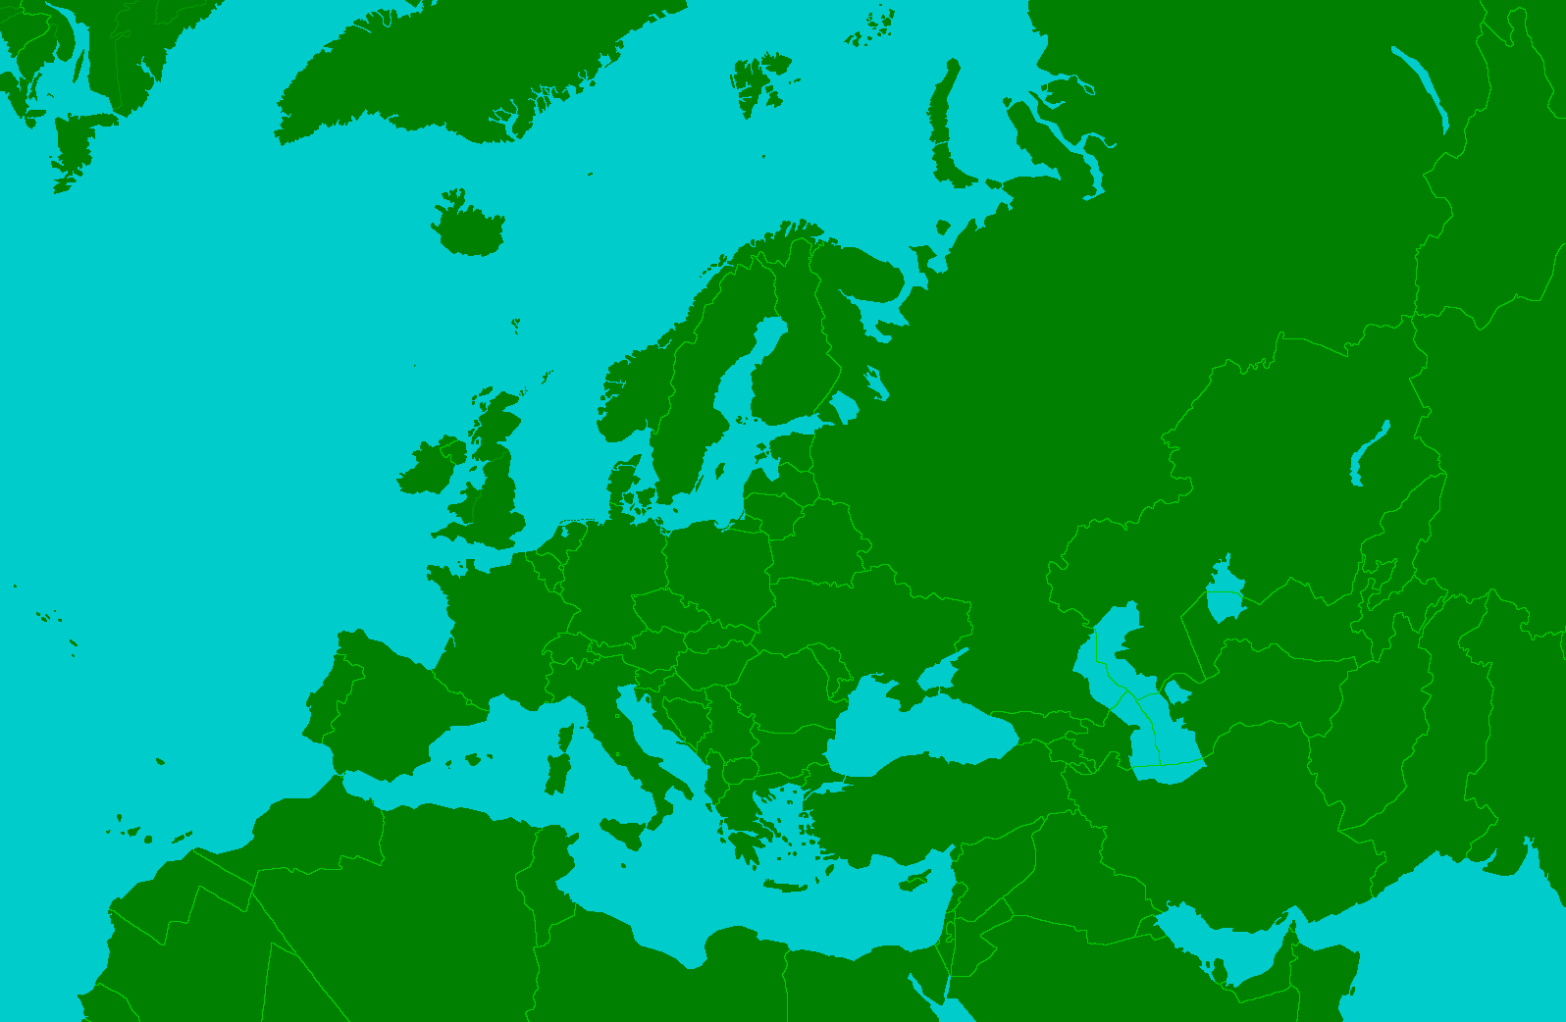
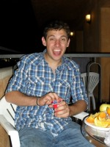
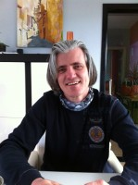
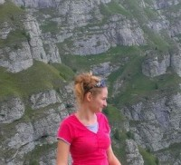
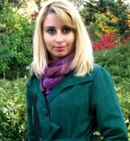
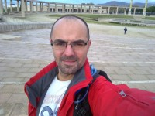
Members
Jonas Van Moer
University: Universiteit Antwerpen
City and country: Beveren-Waas, Belgium
Economics
Philippe Van Mullem
University: Open University Hasselt
City and country: Sint-Truiden, Belgium
Green energy
Bianca Stanciulescu
University: University of Bucharest
City and country: Bucharest, Romania
Cultural and geological heritage
Cristina Toma
University: The University of Bucharest
City and country: Bucharest, Romania
Cultural and social heritage
Claudio Jardim
University: Universidade Aberta
City and country: Funchal / Madeira / Portugal
Sustainable Tourism
EVS 2013-2014 GEO2 Group

Slide 15
how we made use of the diversity of disciplinary and national backgrounds in the research work.
Getting advantage of the multidisciplinary diversity
The National diversity was of great value since we had two persons that are from the country of the research to be done
The difference in ages was also a plus in the group
The use of a common language was the most essential point
Having totally different points of view is very enriching
The many emails and skype meetings and the use of EVS platform was a common tool for us all, and a way of being all together working
EVS 2013-2014 GEO2 Group

Slide 16
Thank you all
We are grateful to our respective Universities, which enabled us to put our theoretical knowledge to practise in this case study.
We also would like to thank our mentor, C. Ciobanu, prof. A. Andrasanu and prof. Joop de Kraker for their support and assistance where needed.
We sincerely hope that our work will contribute to achieve sustainable development in the Hateg Geopark in Romania.
EVS 2013-2014 GEO2 Group

